Slide 1
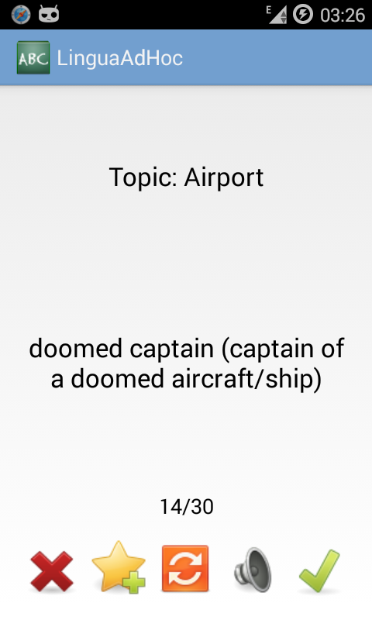
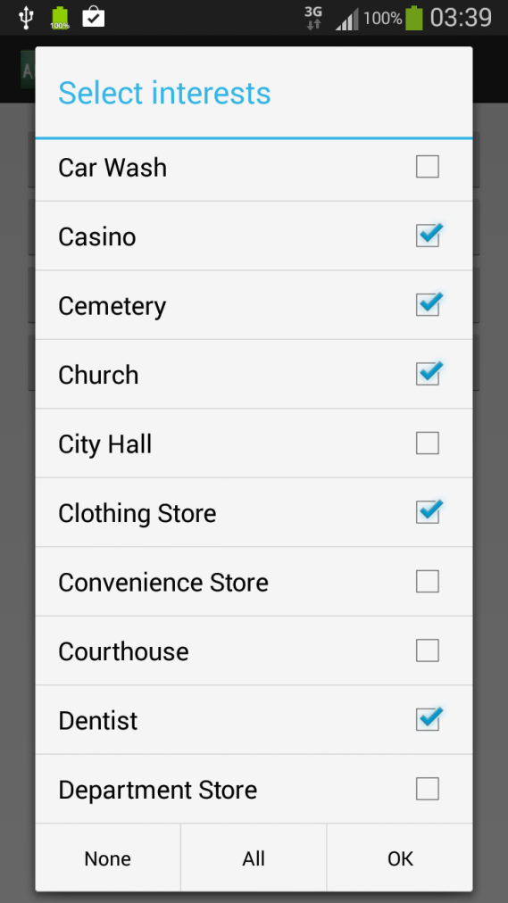
Lingua Ad Hoc
Location aware vocabulary!
Choose your favourite topics!
Articulation included!
Learn while exploring!

